Slide 1
S1B: Introduction
CS1101S AY20/21 Sem 1
Studio 1D
Lee Wei Min
Notes:
Add studio name

Slide 2
Table of Contents
Introduction to Source
Primitives
Combinations
Abstraction
Functions

Slide 3

Introduction to Source
Javascript translation of Lisp

Slide 4
What Features Should a Programming Language Have?

Slide 5


Slide 6
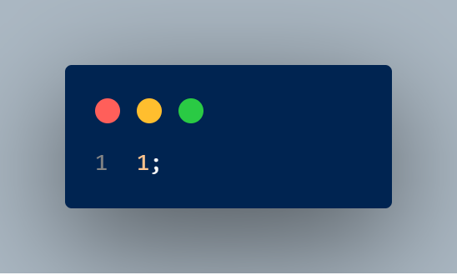
Primitives
Semicolon – to convert expression into program
Expression – in this case a number expression
Notes:
primitive expressions represent the simplest entities
Prints 1

Slide 7


Slide 8
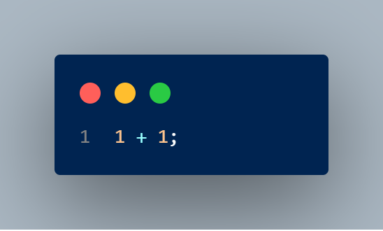
Combinations
1 + 1;
2;
Operand
Operator
Notes:
Prints 2

Slide 9
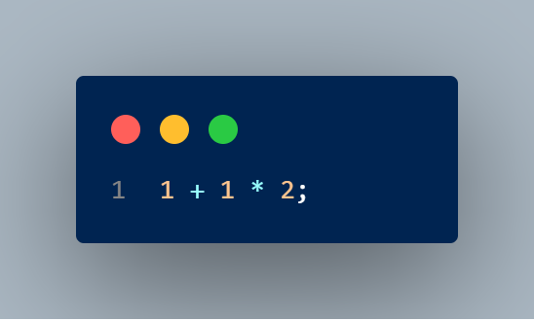
Operator Precedence
1 + 1 * 2;
1 + 2;
3;
Notes:
Prints 3

Slide 10
How do we model the real world?

Slide 11
How do we manage complexity?

Slide 12
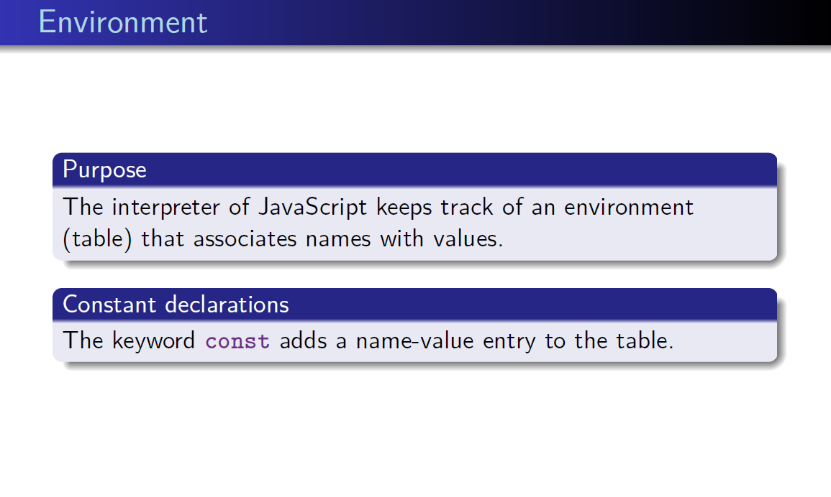
Notes:
What is an interpreter?
- An interpreter is a computer program that directly executes programs without compiling into machine language.

Slide 13
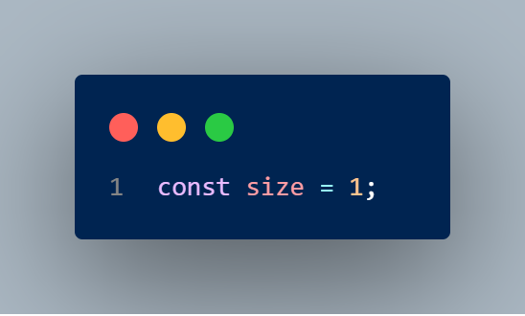
Naming
With a value 1
Name | Value
size | 1
Keyword – declares a constant: adds name-value entry to environment
Name is “size”

Slide 14


Slide 15
Black-box Abstraction

Slide 16
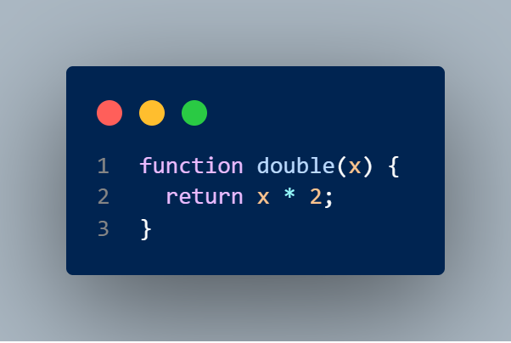
Function Declaration
Name is “double”
Parameter: takes in a value and names it “x”
Keyword – declares a function: adds name-value entry to environment
Returns x multiplied by 2
Notes:
Parameter vs argument?
A parameter is a variable in a method definition. When a method is called, the arguments are the data you pass into the method's parameters.

Slide 17
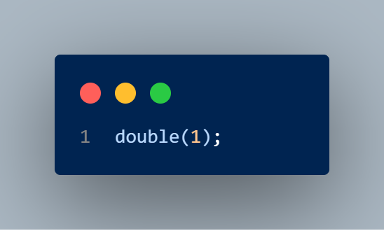
Function Application
Apply the function double using brackets
Pass in 1 as Argument

Slide 18
1
2
Double()

Slide 19
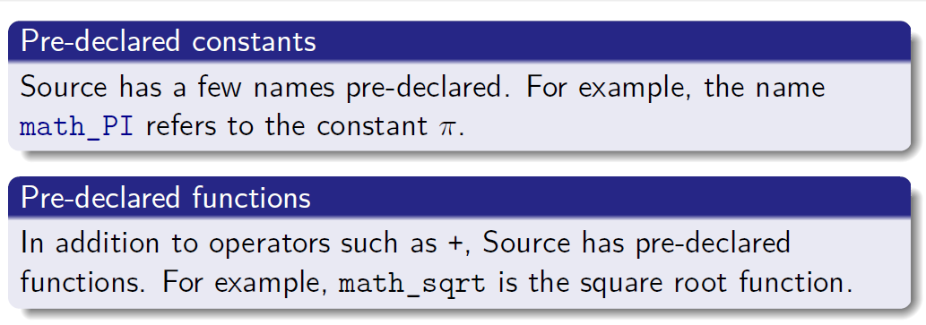
Pre-declared Functions and Constants

Slide 20
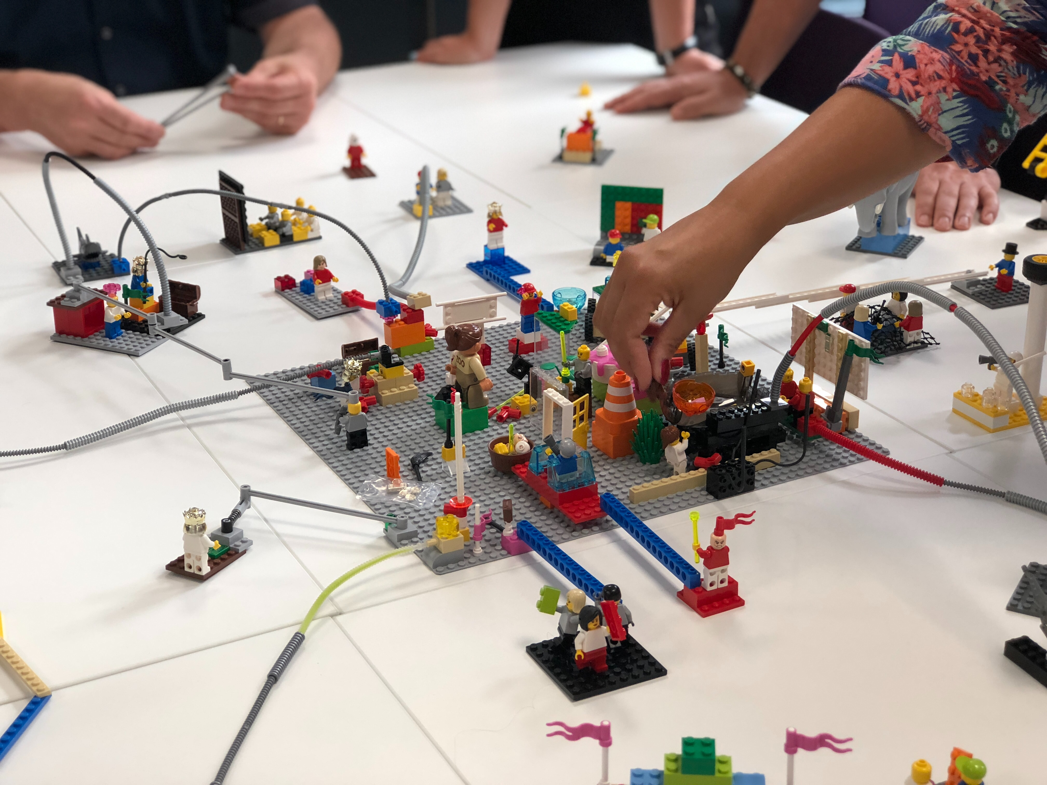

Slide 21
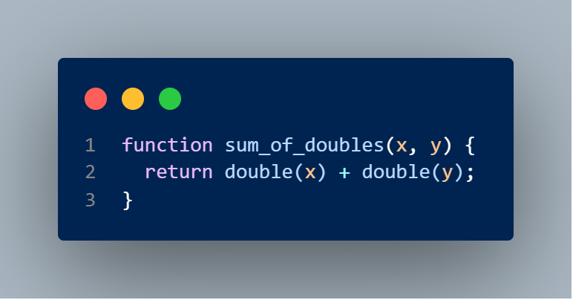
Compound Function

Slide 22
1
2
double()
1, 2
6
+
= 6
sum_of_doubles()
2
4
double()

Slide 23
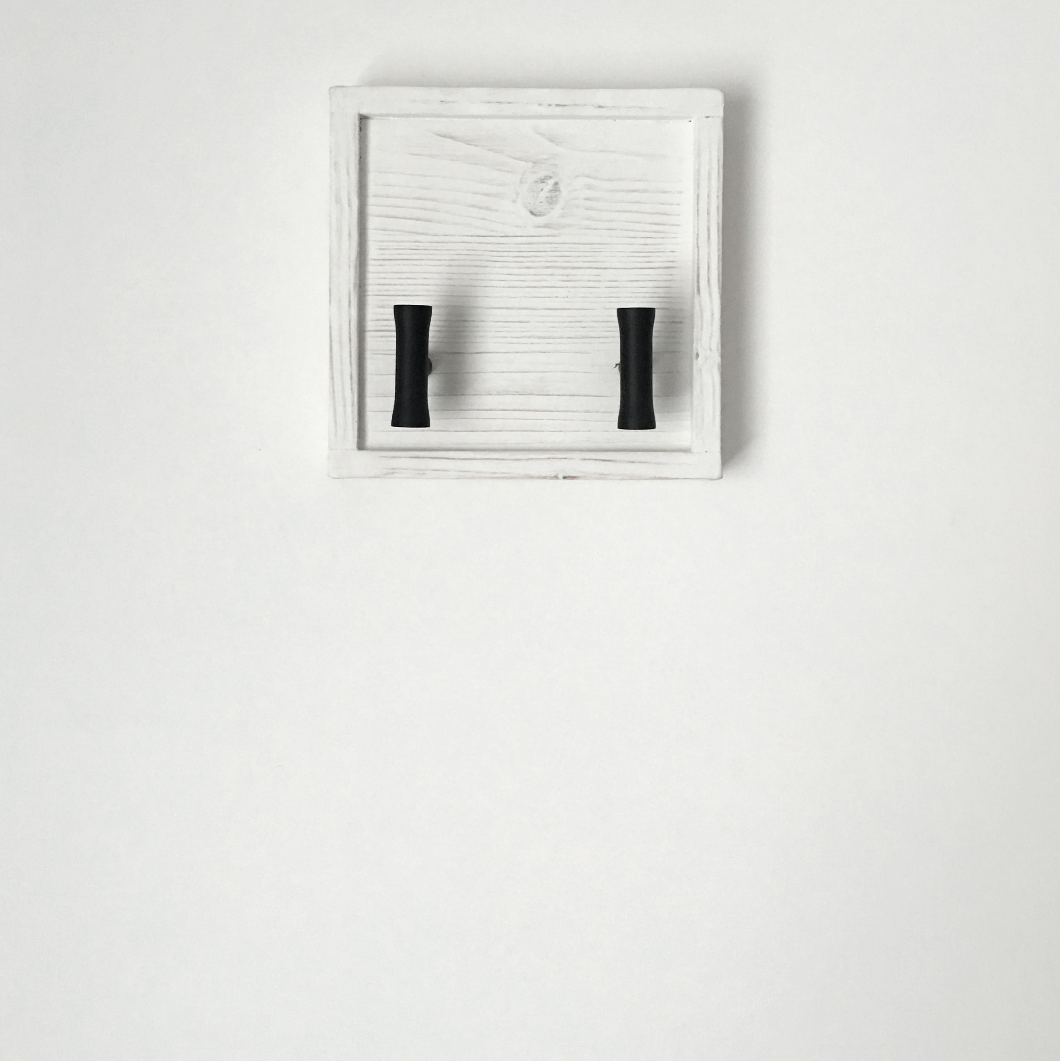

Slide 24
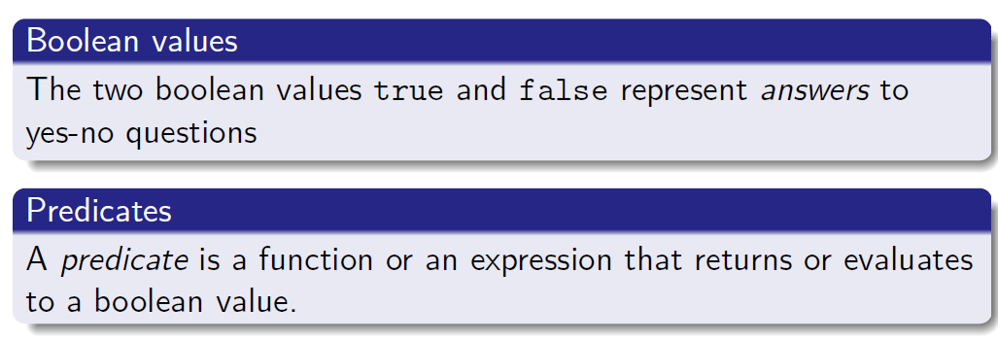
Booleans

Slide 25
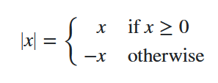
Conditionals

Slide 26
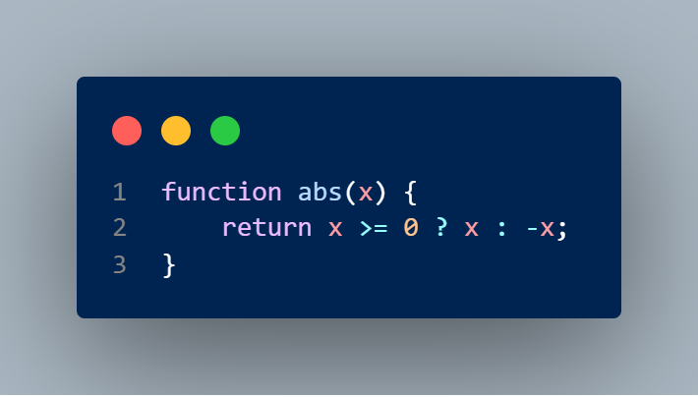
Conditional Expression
If true
If false
Predicate

Slide 27
Resources
Lecture 1A
Textbook: 1.1.1, 1.1.2, 1.1.4, 1.1.6

Slide 28
Shortcuts
Autocomplete: tab
Comment line: Ctrl + /
Run program: Shift + Enter

Slide 29
Questions?

Slide 30
Studio sheet

Slide 31
Feedback
https://leeweimin84964.typeform.com/to/vklpn325

